Slide 1
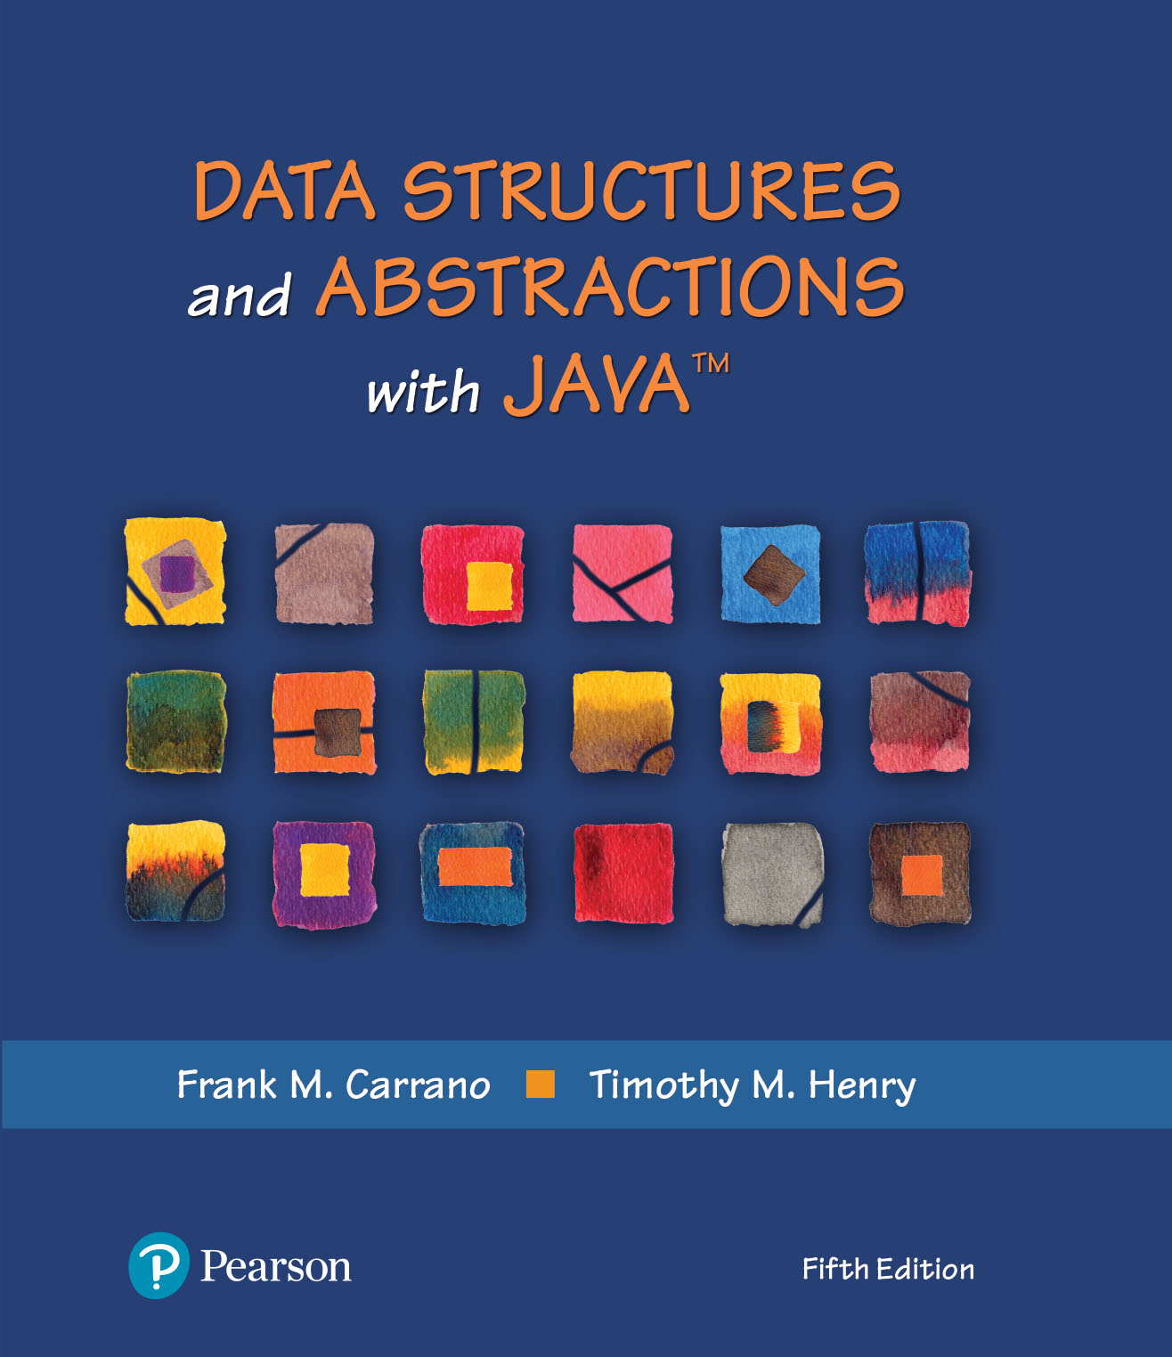
Data Structures and Abstractions with Java™
5th Edition
Module 4 – Array Based ADT
Includes:
Chapter 2 - Bag Implementations
That Use Arrays

Slide 2
Overview Of Array-Based Structures
Array is a data structure built into virtually all programming languages
Many programmer-defined data structures use arrays as their foundation
These structures are called array-based structures
Like all structures, array-based structures
Are implemented as a separate class
Can be dynamic (expand their maximum capacity at runtime)
Can be generic (store any type of node)
Java’s ArrayList class models a generic array-based data structure
2

Slide 3
Overview Of Array-Based Structures
Array is a data structure built into virtually all programming languages
Many programmer-defined data structures use arrays as their foundation
These structures are called array-based structures
Like all structures, array-based structures
Are implemented as a separate class
Can be dynamic (expand their maximum capacity at runtime)
Can be generic (store any type of node)
Java’s ArrayList class models a generic array-based data structure

Slide 4
Array Design Considerations
Because of the basic design of arrays
Each variable has a unique ordinal subscript
There is a minimum and maximum value of the subscript
All values stored in a set of variables are of one type
It allows for a contiguous memory model access using a mapping function

Slide 5

Fixed-Size Array to Implement the ADT Bag
FIGURE 2-1 A classroom that contains desks in fixed positions

Slide 6
UML for a fixed size ArrayBag
ArrayBag
-bag: T[] -numberOfEntries: integer -DEFAULT_CAPACITY: integer
+getCurrentSize(): integer +isEmpty(): boolean +add(newEntry: T): boolean +remove(): T +remove(anEntry: T): boolean +clear(): void +getFrequencyOf(anEntry: T): integer +contains(anEntry: T): boolean +toArray(): T[] –isArrayFull(): boolean
FIGURE 2-2 UML notation for the class ArrayBag, including the class’s data fields

Slide 7
The Class ArrayBag (Part 1)
/**A class of bags whose entries are stored in a fixed-size array.
INITIAL, INCOMPLETE DEFINITION; no security checks */
public final class ArrayBag<T> implements BagInterface<T>
{
private final T[] bag;
private int numberOfEntries;
private static final int DEFAULT_CAPACITY = 25;
/** Creates an empty bag whose initial capacity is 25. */
public ArrayBag()
{
this(DEFAULT_CAPACITY);
} // end default constructor
/** Creates an empty bag having a given initial capacity.
@param desiredCapacity The integer capacity desired. */
public ArrayBag(int desiredCapacity)
{
// The cast is safe because the new array contains null entries.
@SuppressWarnings("unchecked")
T[] tempBag = (T[])new Object[desiredCapacity]; // Unchecked cast
bag = tempBag;
numberOfEntries = 0;
} // end constructor
LISTING 2-1 An outline of the class ArrayBag

Slide 8
The Class ArrayBag (Part 2)
/** Adds a new entry to this bag.
@param newEntry The object to be added as a new entry.
@return True if the addition is successful, or false if not. */
public boolean add(T newEntry)
{
// To be defined
} // end add
/** Retrieves all entries that are in this bag.
@return A newly allocated array of all the entries in this bag. */
public T[] toArray()
{
// To be defined
} // end toArray
// Returns true if the array bag is full, or false if not.
private boolean isArrayFull()
{
// To be defined
} // end isArrayFull
} // end ArrayBag
LISTING 2-1 An outline of the class ArrayBag

Slide 9
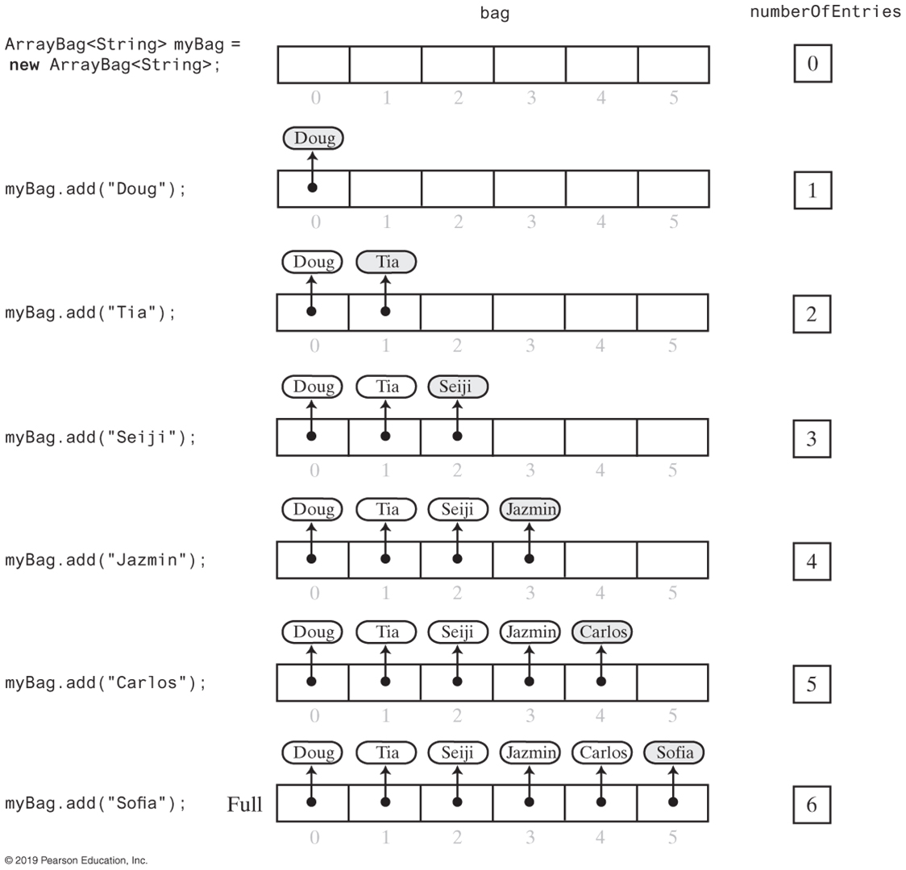
Adding to a fixed-size ArrayBag (Part 1)
FIGURE 2-3 Adding entries to an array that represents a bag, whose capacity is six, until it becomes full

Slide 10
Adding to a fixed-size ArrayBag (Part 2)
FIGURE 2-3 Adding entries to an array that represents a bag, whose capacity is six, until it becomes full

Slide 11
Fixed-Size ArrayBag
/** Adds a new entry to this bag.
@param newEntry the object to be added as a new entry.
@return True if the addition is successful, or false if not.*/
public boolean add(T newEntry)
{
boolean result = true;
if (isArrayFull())
{
result = false;
}
else
{ // Assertion: result is true here
bag[numberOfEntries] = newEntry;
numberOfEntries++;
} // end if
return result;
} // end add
Method add

Slide 12
Fixed-Size ArrayBag
// Returns true if this bag is full, or false if not.
private boolean isArrayFull()
{
return numberOfEntries >= bag.length;
} // end isArrayFull
Method isFull

Slide 13
Fixed-Size ArrayBag
/** Retrieves all entries that are in this bag.
@return A newly allocated array of all
the entries in the bag. */
public T[] toArray()
{
// The cast is safe because the new array
// contains null entries.
@SuppressWarnings("unchecked")
T[] result = (T[])new Object[numberOfEntries]; // Unchecked cast
for (int index = 0; index < numberOfEntries; index++)
{
result[index] = bag[index];
} // end for
return result;
} // end toArray
Method toArray

Slide 14
Making the Implementation Secure
Practice fail-safe programming by including checks for anticipated errors
Validate input data and arguments to a method
refine incomplete implementation of ArrayBag to make code more secure by adding the following two data fields
private boolean integrityOK = false;
private static final int MAX_CAPACITY = 10000;

Slide 15
Making the Implementation Secure
/** Creates an empty bag having a given capacity.
@param desiredCapacity The integer capacity desired. */
public ArrayBag2(int desiredCapacity)
{
if (desiredCapacity <= MAX_CAPACITY)
{
// The cast is safe because the new array contains null entries
@SuppressWarnings("unchecked")
T[] tempBag = (T[])new Object[desiredCapacity]; // Unchecked cast
bag = tempBag;
numberOfEntries = 0;
integrityOK = true;
}
else
throw new IllegalStateException("Attempt to create a bag whose" +
"capacity exceeds allowed maximum.");
} // end constructor
Revised constructor

Slide 16
Making the Implementation Secure
// Throws an exception if this object is not initialized.
private void checkIntegrity()
{
if (!integrityOK)
throw new SecurityException("ArrayBag object is corrupt.");
} // end checkIntegrity
Method to check initialization

Slide 17
Making the Implementation Secure
/** Adds a new entry to this bag.
@param newEntry The object to be added as a new entry.
@return True if the addition is successful, or false if not. */
public boolean add(T newEntry)
{
checkIntegrity();
boolean result = true;
if (isArrayFull())
{
result = false;
}
else
{ // Assertion: result is true here
bag[numberOfEntries] = newEntry;
numberOfEntries++;
} // end if
return result;
} // end add
Revised method add

Slide 18
Testing the Core Methods
/** Removes one unspecified entry from this bag, if possible.
@return Either the removed entry, if the removal
was successful, or null */
public T remove()
{
return null; // STUB
} // end remove
/** Removes one occurrence of a given entry from this bag.
@param anEntry The entry to be removed
@return True if the removal was successful, or false otherwise */
public boolean remove(T anEntry)
{
return false; // STUB
} // end remove
/** Removes all entries from this bag. */
public void clear()
{
// STUB
} // end clear
Stubs for remove and clear

Slide 19
Testing the Core Methods (Part 1)
/** A test of the constructors and the methods add and toArray,
as defined in the first draft of the class ArrayBag. */
public class ArrayBagDemo1
{
public static void main(String[] args)
{
// Adding to an initially empty bag with sufficient capacity
System.out.println("Testing an initially empty bag with " +
" sufficient capacity:");
BagInterface<String> aBag = new ArrayBag1<>();
String[] contentsOfBag1 = {"A", "A", "B", "A", "C", "A"};
testAdd(aBag, contentsOfBag1);
// Filling an initially empty bag to capacity
System.out.println("\nTesting an initially empty bag that " +
" will be filled to capacity:");
aBag = new ArrayBag1<>(7);
String[] contentsOfBag2 = {"A", "B", "A", "C", "B", "C", "D",
"another string"};
testAdd(aBag, contentsOfBag2);
} // end main
LISTING 2-2 A program that tests core methods of the class ArrayBag

Slide 20
Testing the Core Methods (Part 2)
// Tests the method add.
private static void testAdd(BagInterface<String> aBag, String[] content)
{
System.out.print("Adding the following strings to the bag: ");
for (int index = 0; index < content.length; index++)
{
if (aBag.add(content[index]))
System.out.print(content[index] + " ");
else
System.out.print("\nUnable to add " + content[index] +
" to the bag.");
} // end for
System.out.println();
displayBag(aBag);
} // end testAdd
LISTING 2-2 A program that tests core methods of the class ArrayBag

Slide 21
Testing the Core Methods (Part 3)
// Tests the method toArray while displaying the bag.
private static void displayBag(BagInterface<String> aBag)
{
System.out.println("The bag contains the following string(s):");
Object[] bagArray = aBag.toArray();
for (int index = 0; index < bagArray.length; index++)
{
System.out.print(bagArray[index] + " ");
} // end for
System.out.println();
} // end displayBag
} // end ArrayBagDemo1
Program Output
Testing an initially empty bag with sufficient capacity:
Adding the following strings to the bag: A A B A C A
The bag contains the following string(s):
A A B A C A
Testing an initially empty bag that will be filled to capacity:
Adding the following strings to the bag: A B A C B C D
Unable to add another string to the bag.
The bag contains the following string(s):
A B A C B C D
LISTING 2-2 A program that tests core methods of the class ArrayBag

Slide 22
Implementing More Methods
/** Sees whether this bag is empty.
@return True if this bag is empty, or false if not. */
public boolean isEmpty()
{
return numberOfEntries == 0;
} // end isEmpty
/** Gets the current number of entries in this bag.
@return The integer number of entries
currently in this bag. */
public int getCurrentSize()
{
return numberOfEntries;
} // end getCurrentSize
Methods isEmpty and getCurrentSize

Slide 23
Implementing More Methods
/** Counts the number of times a given entry appears in this bag.
@param anEntry The entry to be counted.
@return The number of times anEntry appears in this bag. */
public int getFrequencyOf(T anEntry)
{
checkIntegrity();
int counter = 0;
for (int index = 0; index < numberOfEntries; index++)
{
if (anEntry.equals(bag[index]))
{
counter++;
} // end if
} // end for
Method getFrequencyOf

Slide 24
Implementing More Methods
/** Tests whether this bag contains a given entry.
@param anEntry The entry to locate.
@return True if this bag contains anEntry, or false otherwise. */
public boolean contains(T anEntry)
{
checkIntegrity();
boolean found = false;
int index = 0;
while (!found && (index < numberOfEntries))
{
if (anEntry.equals(bag[index]))
{
found = true;
} // end if
index++;
} // end while
return found;
} // end contains
Method contains

Slide 25
Methods That Remove Entries
/** Removes all entries from this bag. */
public void clear()
{
while (!isEmpty())
remove();
} // end clear
The method clear

Slide 26
Methods That Remove Entries
/** Removes one unspecified entry from this bag, if possible.
@return Either the removed entry, if the removal
was successful, or null. */
public T remove()
{
checkIntegrity();
T result = null;
if (numberOfEntries > 0))
{
result = bag[numberOfEntries - 1];
bag[numberOfEntries - 1] = null;
numberOfEntries--;
} // end if
return result;
} // end remove
The method remove

Slide 27
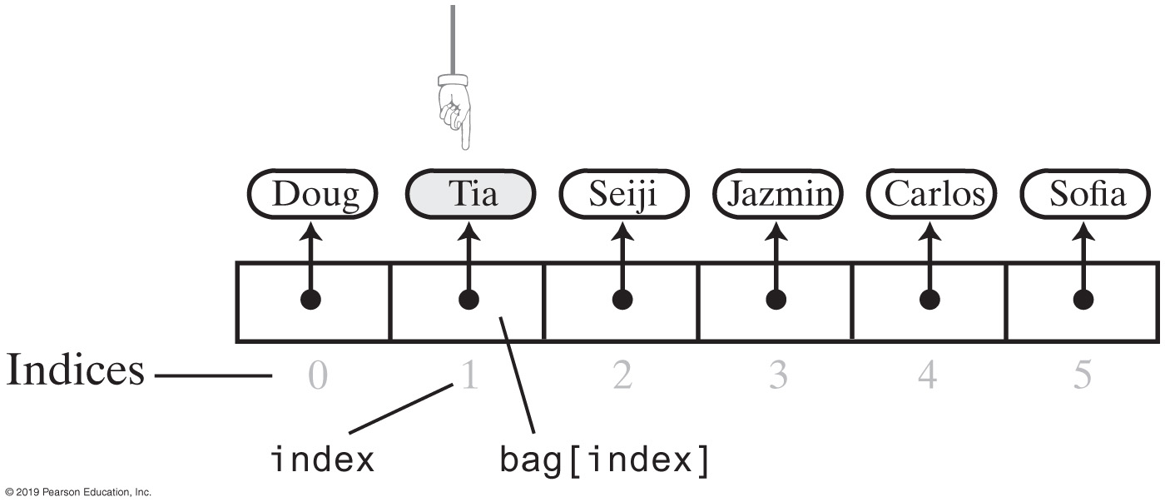
Methods That Remove Entries
FIGURE 2-4 The array bag after a successful search for the string “Tia”

Slide 28
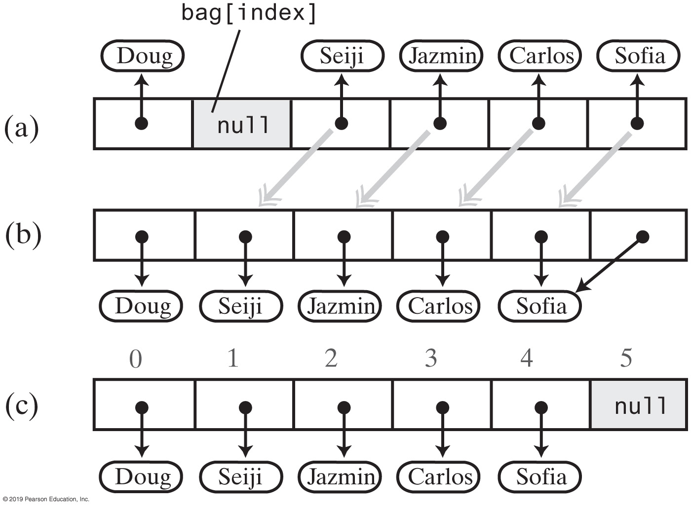
Methods That Remove Entries
Figure 2-5 Shifting entries to avoid a gap when removing an entry
Notes:
FIGURE 2-5
(a) A gap in the array bag after setting the entry in bag[index] to null; (b) the array after shifting subsequent entries to avoid a gap; (c) after replacing the duplicate reference to the last entry with null

Slide 29
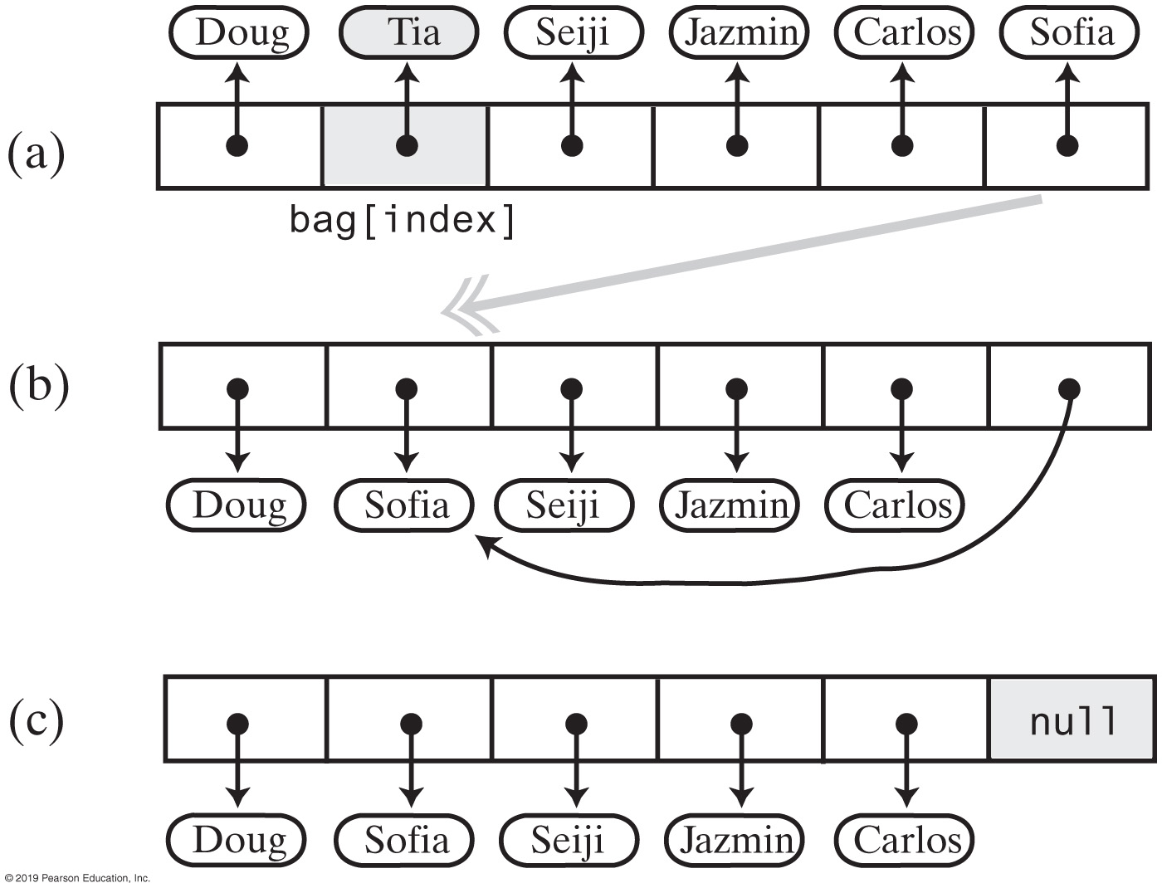
Methods That Remove Entries
FIGURE 2-6 Avoiding a gap in the array while removing an entry

Slide 30
Methods That Remove Entries
// Removes and returns the entry at a given index within the array bag.
// If no such entry exists, returns null.
// Preconditions: 0 <= givenIndex < numberOfEntries;
// checkIntegrity has been called.
private T removeEntry(int givenIndex)
{
T result = null;
if (!isEmpty() && (givenIndex >= 0))
{
result = bag[givenIndex]; // Entry to remove
bag[givenIndex] = bag[numberOfEntries - 1]; // Replace entry with last entry
bag[numberOfEntries - 1] = null; // Remove last entry
numberOfEntries--;
} // end if
return result;
} // end removeEntry
The private helper method removeEntry

Slide 31
Methods That Remove Entries
/** Removes one unspecified entry from this bag, if possible.
@return Either the removed entry, if the removal was successful,
or null otherwise. */
public T remove()
{
checkIntegrity();
T result = removeEntry(numberOfEntries - 1);
return result;
} // end remove
/** Removes one occurrence of a given entry from this bag.
@param anEntry The entry to be removed.
@return True if the removal was successful, or false if not. */
public boolean remove(T anEntry)
{
checkIntegrity();
int index = getIndexOf(anEntry);
T result = removeEntry(index);
return anEntry.equals(result);
} // end remove
The revised remove methods

Slide 32
Methods That Remove Entries
// Locates a given entry within the array bag.
// Returns the index of the entry, if located, or -1 otherwise.
// Precondition: checkIntegrity has been called.
private int getIndexOf(T anEntry)
{
int where = -1;
boolean found = false;
int index = 0;
while (!found && (index < numberOfEntries))
{
if (anEntry.equals(bag[index]))
{
found = true;
where = index;
} // end if
index++;
} // end while
// Assertion: If where > -1, anEntry is in the array bag, and it
// equals bag[where]; otherwise, anEntry is not in the array
return where;
} // end getIndexOf
Definition for the method getIndexOf

Slide 33
Revised Methods
public boolean contains(T anEntry)
{
checkIntegrity();
return getIndexOf(anEntry) > -1; // or >= 0
} // end contains
Revised definition for the method contains

Slide 34
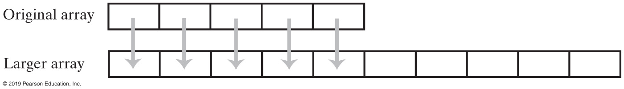
Resizing an Array
FIGURE 2-7 Resizing an array copies its contents to a larger second array

Slide 35
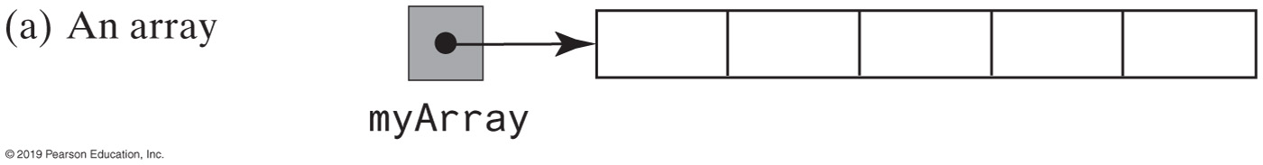
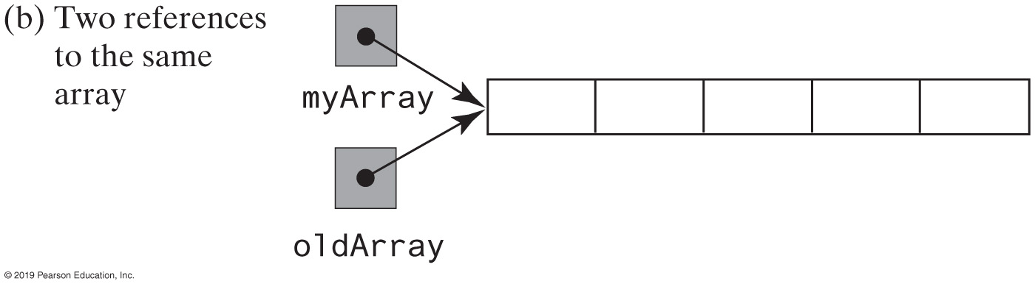
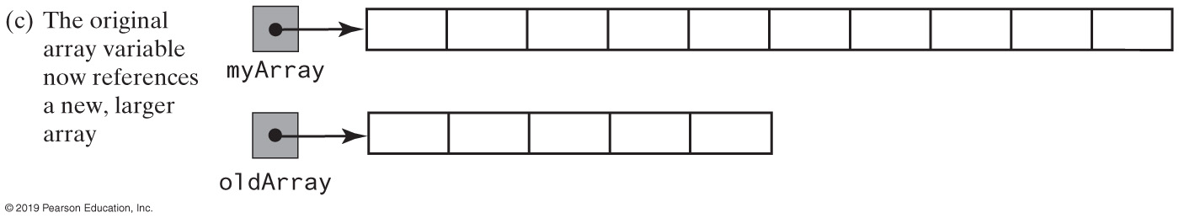
Steps to Resize an Array (Part 1)
FIGURE 2-8 Resizing an array

Slide 36
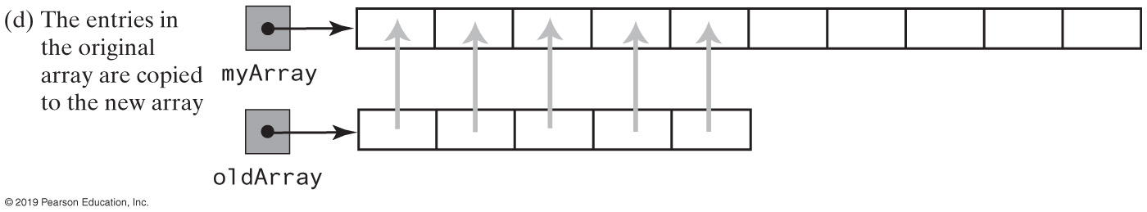
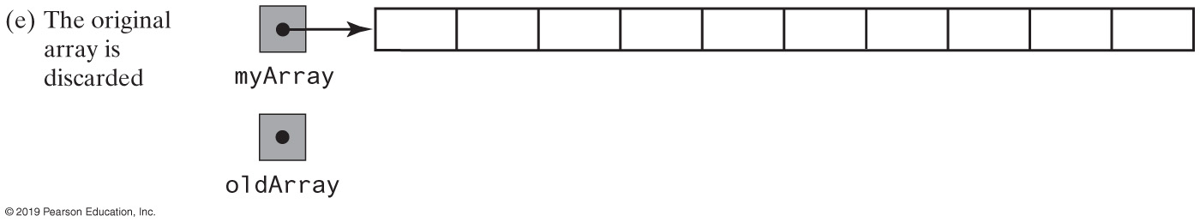
Steps to Resize an Array (Part 2)
FIGURE 2-8 Resizing an array

Slide 37
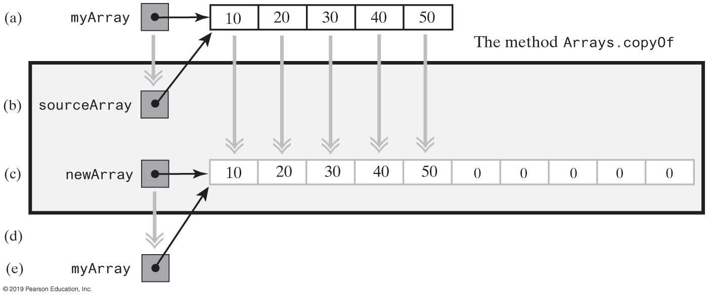
Resizing Using Arrays.copyOf
FIGURE 2-9 Alternative steps to resize an array
Notes:
FIGURE 2-9
The effect of the statement myArray = Arrays.copyOf(myArray, 2 * myArray.length); (a) The argument array

Slide 38
New Implementation of a Bag
/** Adds a new entry to this bag.
@param newEntry The object to be added as a new entry.
@return True. */
public boolean add(T newEntry)
{
checkIntegrity();
boolean result = true;
if (isArrayFull())
{
doubleCapacity();
} // end if
bag[numberOfEntries] = newEntry;
numberOfEntries++;
return true;
} // end add
Revised definition of method add

Slide 39
New Implementation of a Bag
// Throws an exception if the client requests a capacity that is too large.
private void checkCapacity(int capacity)
{
if (capacity > MAX_CAPACITY)
throw new IllegalStateException("Attempt to create a bag whose " +
"capacity exeeds allowed " +
"maximum of " + MAX_CAPACITY);
} // end checkCapacity
// Doubles the size of the array bag.
// Precondition: checkIntegrity has been called.
private void doubleCapacity()
{
int newLength = 2 * bag.length;
checkCapacity(newLength);
bag = Arrays.copyOf(bag, newLength);
} // end doubleCapacity
The methods checkCapacity and doubleCapacity

Slide 40
Pros and Cons of Using an Array
Adding an entry to the bag is fast
Removing an unspecified entry is fast
Removing a particular entry requires time to locate the entry
Increasing the size of the array requires time to copy its entries

Slide 41
Sorted Array Structure
All elements of the array are initialized to null
Nodes are stored in sorted order based on key
getIndexOf uses a binary search
remove
uses getIndexOf with binary search
moves up all node references below the deleted node
add
Places the inserted node in its sorted order position
After moving larger nodes references down in array

Slide 42
Unsorted-Optimized Structure
All elements of the array are initialized to null
The add algorithm is the same as the Unsorted Array structure, O(1)
The getIndexOf and remove algorithms of the Unsorted Array structure are modified to improve their speed

Slide 43
Unsorted-Optimized Fetch Improvement
A sequential search is still used to locate a node, however:
After a node is fetched (getIndexOf), its reference is swapped with the reference above it
Most frequently fetched nodes “bubble-up” to the top of the array
This reduces the average number of times subsequent sequential searches execute
Nodes in most data bases don’t have equal probability of being fetched

Slide 44
Array-based lists in Java Library
Look at the definition of the List Interface

Slide 45
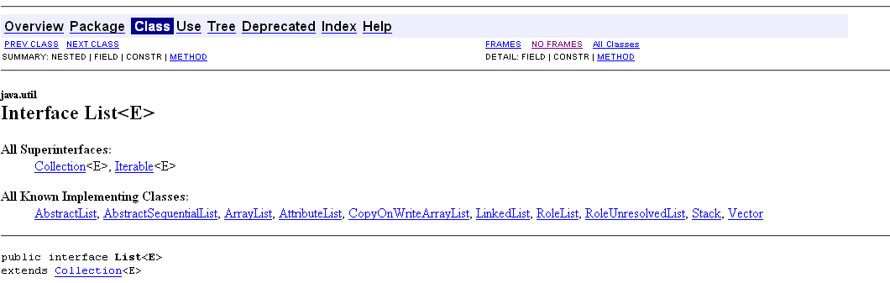
List Interface
An ordered collection (also known as a sequence). The user of this interface has precise control over where in the list each element is inserted. The user can access elements by their integer index (position in the list), and search for elements in the list.
Unlike sets, lists typically allow duplicate elements. More formally, lists typically allow pairs of elements e1 and e2 such that e1.equals(e2), and they typically allow multiple null elements if they allow null elements at all. It is not inconceivable that someone might wish to implement a list that prohibits duplicates, by throwing runtime exceptions when the user attempts to insert them, but we expect this usage to be rare.

Slide 46
List Interface
The List interface provides four methods for positional (indexed) access to list elements. Lists (like Java arrays) are zero based. Note that these operations may execute in time proportional to the index value for some implementations (the LinkedList class, for example). Thus, iterating over the elements in a list is typically preferable to indexing through it if the caller does not know the implementation.
The List interface provides a special iterator, called a ListIterator, that allows element insertion and replacement, and bidirectional access in addition to the normal operations that the Iterator interface provides. A method is provided to obtain a list iterator that starts at a specified position in the list.
The List interface provides two methods to search for a specified object. From a performance standpoint, these methods should be used with caution. In many implementations they will perform costly linear searches.
The List interface provides two methods to efficiently insert and remove multiple elements at an arbitrary point in the list.

Slide 47
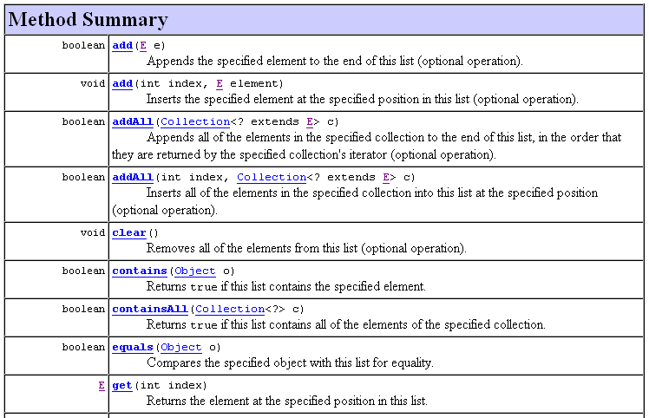

Slide 48
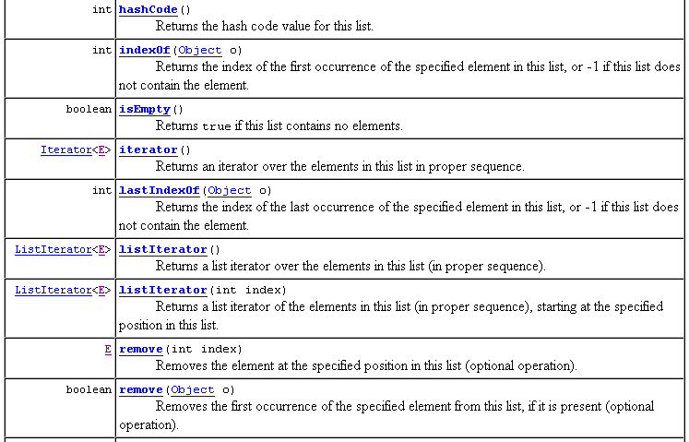
Node number mode
Key field mode

Slide 49
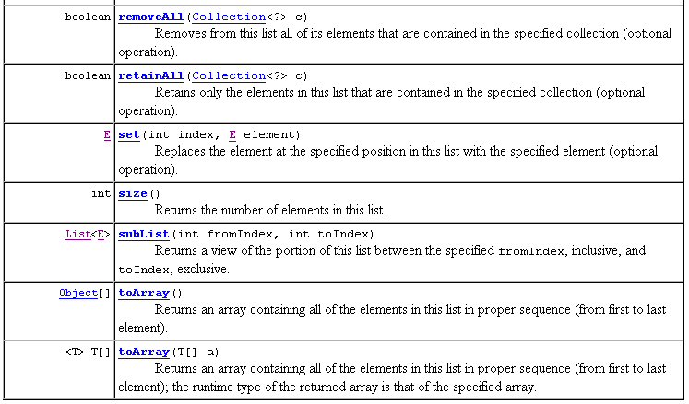

Slide 50
Java’s API ArrayList Class
A generic data structure
Access is in the node number mode
Supports the basic operations
Not encapsulated
Stores objects, but primitive types are wrapped automatically in Wrapper objects
expandable
Client code
ArrayList <Car> garage = new ArrayList<Car> (200)
for an initial capacity of 200 Car objects (default is a capacity of 10)
50

Slide 51
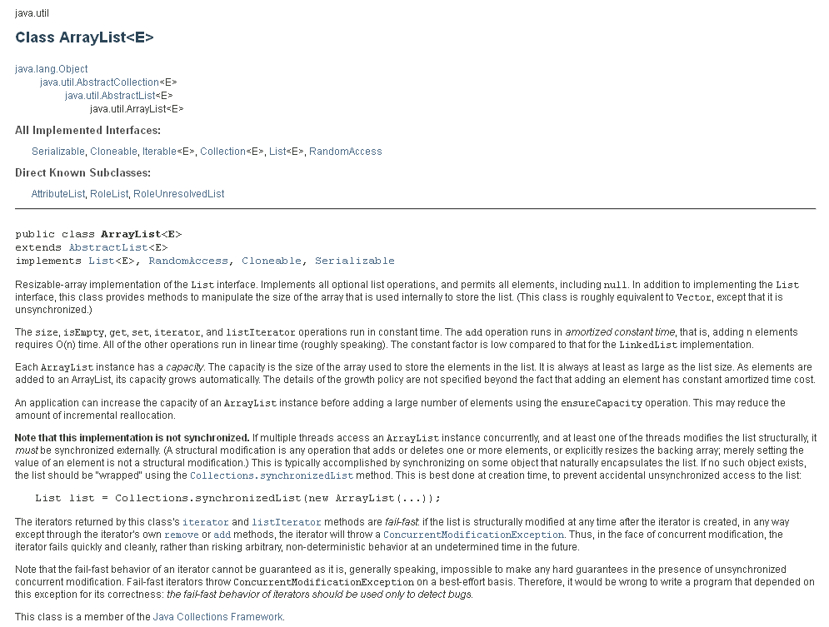

Slide 52
Basic Operations in the Class ArrayList
Basic Operation | ArrayList Method Name | Coding Example Assumes the declaration ArrayList boston = new ArrayList(); | Comments
add | add | boston.add(tom); // uses index 0 boston.add(mary); // uses index 1 boston.add(21); // uses index 2 | the 21 gets wrapped
getIndexOf | get | temp = (Node) boston.get(1) // fetch mary temp = (Node) boston.get(0) // fetch tom int i = (Integer) boston.get(2) // fetch 21 | coercion not necessary for homogeneous object declarations
remove | remove | boston.remove(1); // mary is deleted | 21 moves up to index 1
update | set | boston.set(0, mary); // tom now mary boston.set(1, 999.78); // 21 now 999.89 | The 999.78 gets wrapped
ArrayList boston = new ArrayList();
Declares boston to be a heterogeneous structure
(unparametized, requires datatype casting)
52

